Slide 1

P6 - Cryptocurrency Exchange Database Project
A comprehensive end-to-end secure transaction system.
Group 6:
Aditya Hasija
Revan Chonnad
Hishita Thakkar
Siyao Li
Harini T.

Slide 2




Objective, Scope & Purpose
Objective
Build a secure, scalable relational database for a cryptocurrency exchange platform.
Support wallet operations, KYC verification, order tracking, and customer service features.
Scope
Encompasses transactions, digital wallets, user accounts, KYC processes, orders, and support tickets..
Purpose
Ensure secure data handling through encryption techniques.
Generate valuable business insights via analytics and visualization tools.

Slide 3
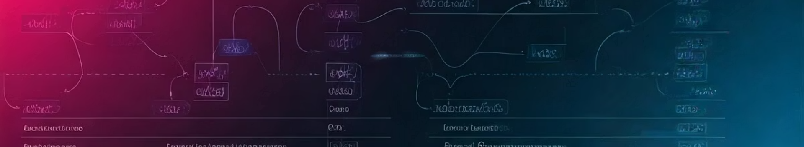
Entities
Users
Digital Wallet
Transactions
Cryptocurrencies
Orders
KYC Documents
Support Tickets
Employee
Report
User Holding

Slide 4
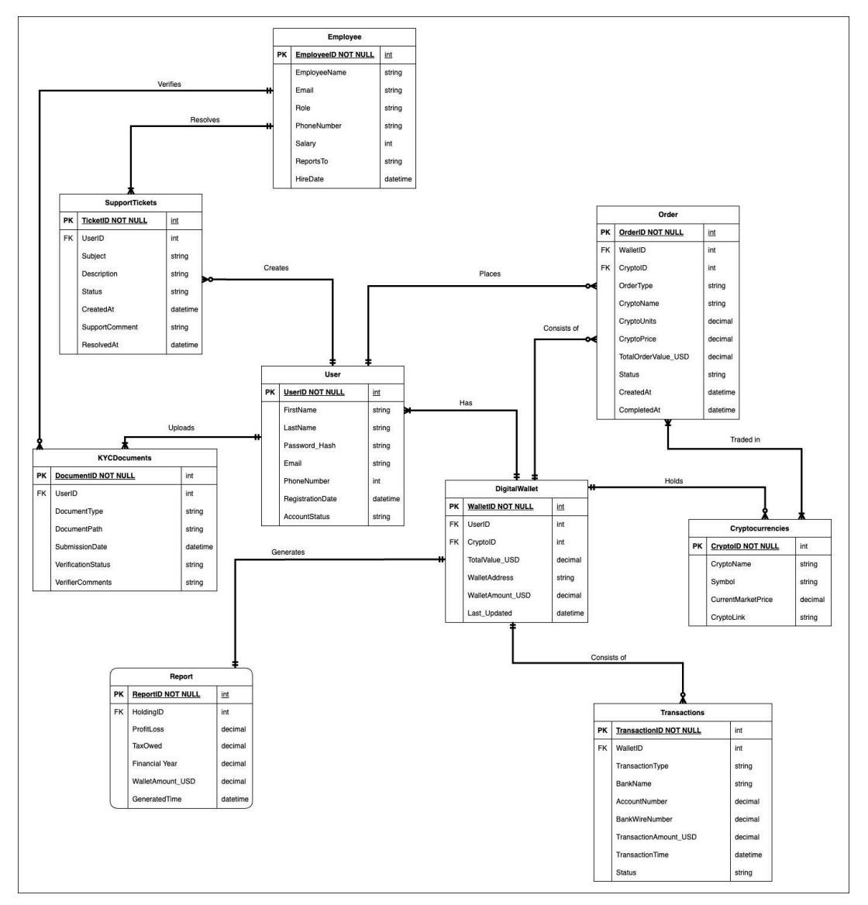
ER Diagram:
e

Slide 5

Functional Working
The CryptoExchangeDB database powers a cryptocurrency exchange by managing users, their fiat and crypto balances, and all trading activities. Users register, complete KYC verification, and are assigned a DigitalWallet for holding USD. They can deposit or withdraw funds via Transactions, and place buy or sell Orders for cryptocurrencies, with each trade updating their UserHoldings and wallet balances.
Key entities include Users, KYCDocuments for identity verification, DigitalWallet for fiat storage, Cryptocurrencies for available assets, and UserHoldings for tracking crypto balances. Transactions record fiat movements, Orders handle trading, and SupportTickets allow users to seek help, with Employees resolving issues and generating Reports for compliance and operations

Slide 6




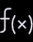



Business Logic with UDFs & Triggers
User-Defined Functions
Triggers
fn_GetUserPortfolioValues - retrieves currency value of crypto that the user posses.
trg_userChangeLogs
trg_TransactionLogs
fn_GetUserKYCStatus - retrieves the KYC status of the users.
Query Optimization
Nonclustered Indexes
Minimize execution plan recompilation
Reduce round-trips between application and database
Optimize I/O and memory usage during peak user load
On Orders
.
On transactions

Slide 7




Technical Specifications
Azure Database Studio
Streamlit - pandas & plotly
Github, Docker
Tableau

